Slide 1

Git and Github

Slide 2

Version Control System
VCS: A system of recording changes to files.
Write a novel yay!

Slide 3

A system that:
Records changes made
Can recover previous versions
Allows us to work independently in a team
Stores files in one place
Introducing
Git: A distributed VCS that takes ‘snapshots’ of your project.
GitHub: A platform to host & collab on repositories (project).

Slide 4
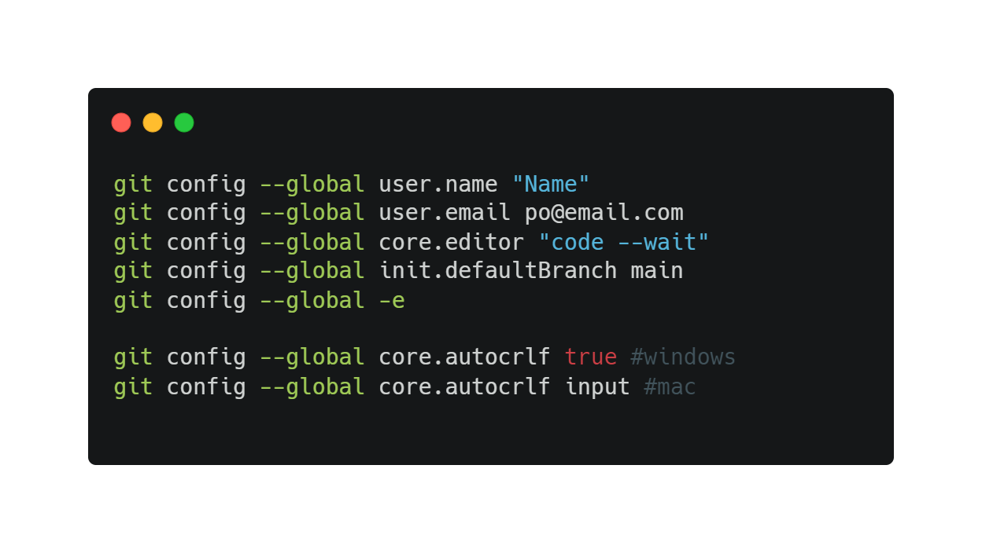
Installing & Configuring Git
Install Git for Windows or type git –-version in Mac terminal
Use GitBash (Windows) or terminal (Mac)
SYSTEM
All users
GLOBAL
All repos of current users
LOCAL
Current repo

Slide 5
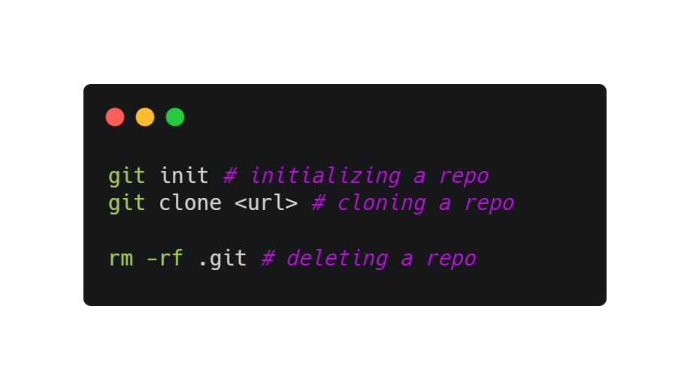
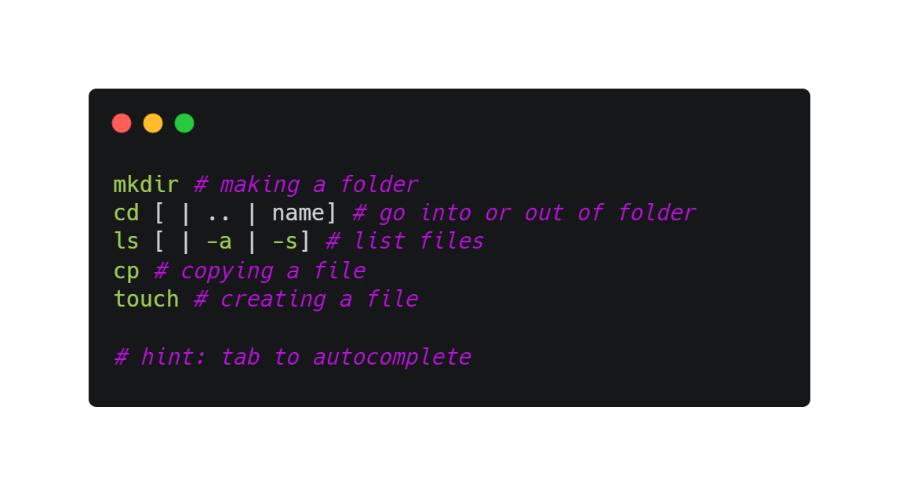
Initializing a Repo
A repository is a place to store all your project files.
Contains .git files (hidden)
Remote repository vs local repository

Slide 6
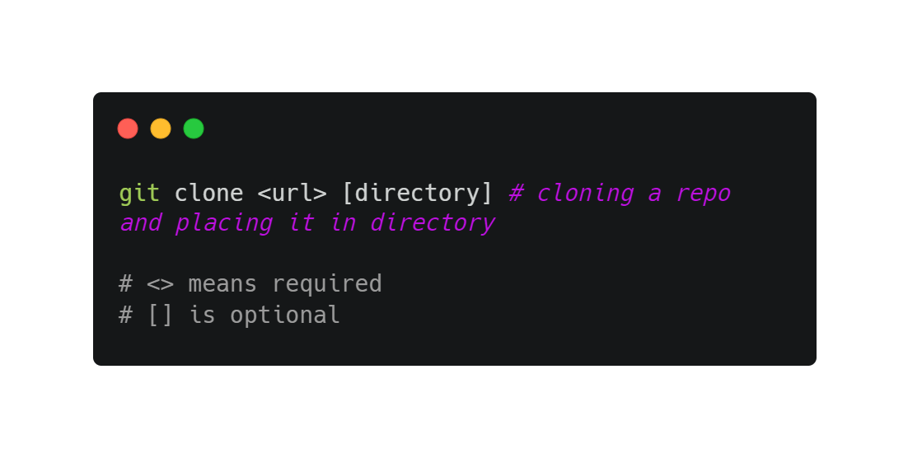
Cloning an existing repo
A full copy of nearly all data is retrieved
Includes all versions of the project
Why?

Slide 7
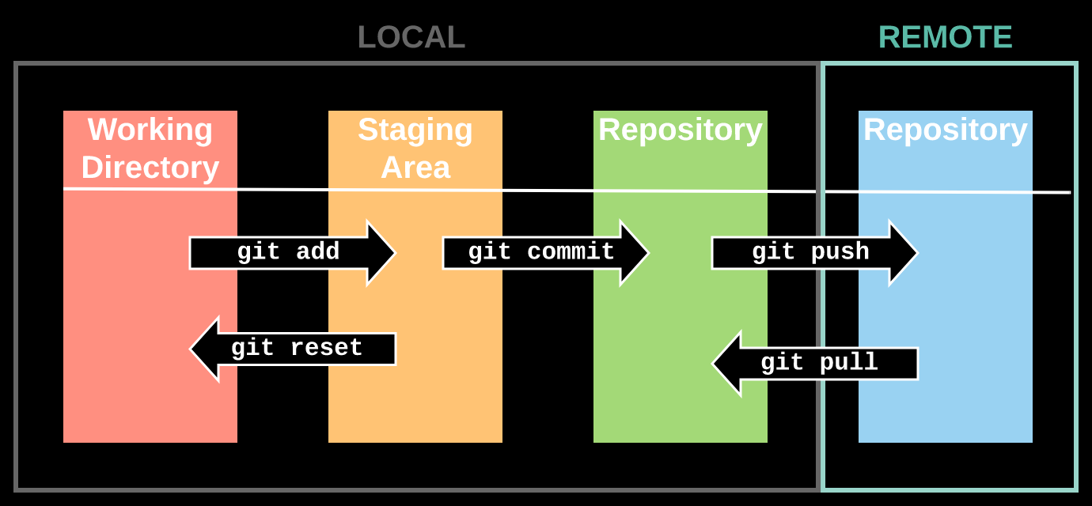
Git Workflow

Slide 8

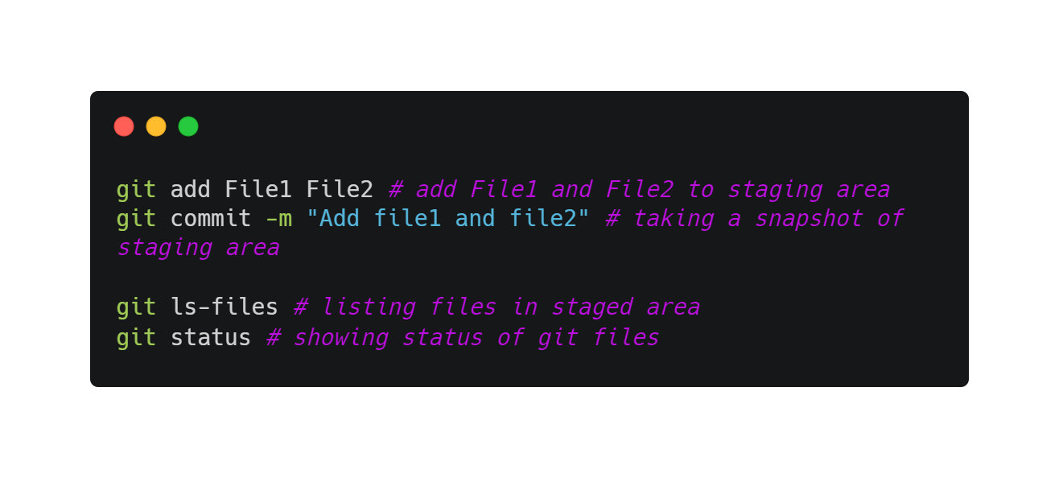
Flow
Staging area
Local repo
File 1
File 1
File 2
File 1
File 1
File 2
File 1
File 1
File 2
File 2

Slide 9
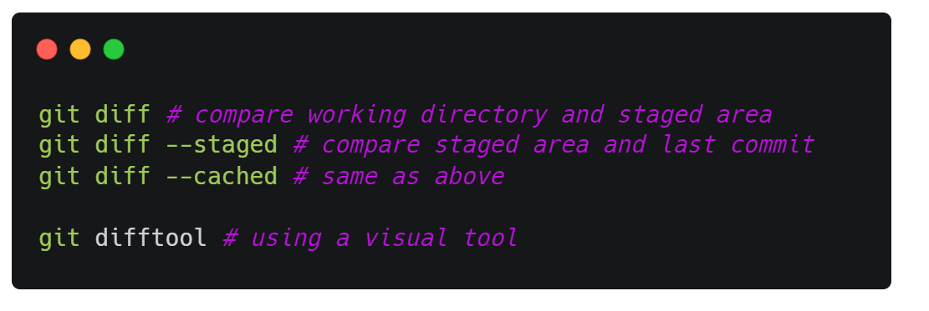
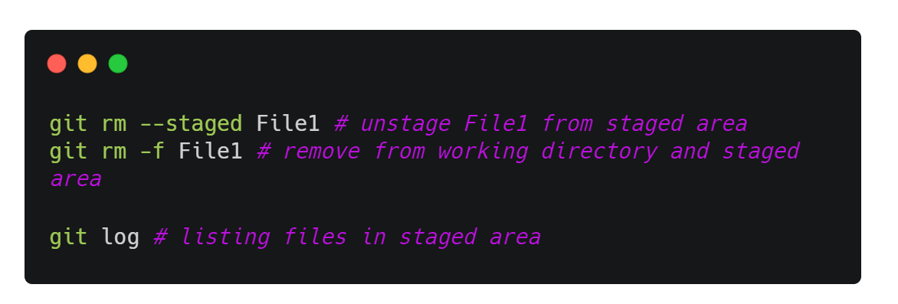
viewing changes
undoing changes
What happens if you remove the file from working directory?

Slide 10
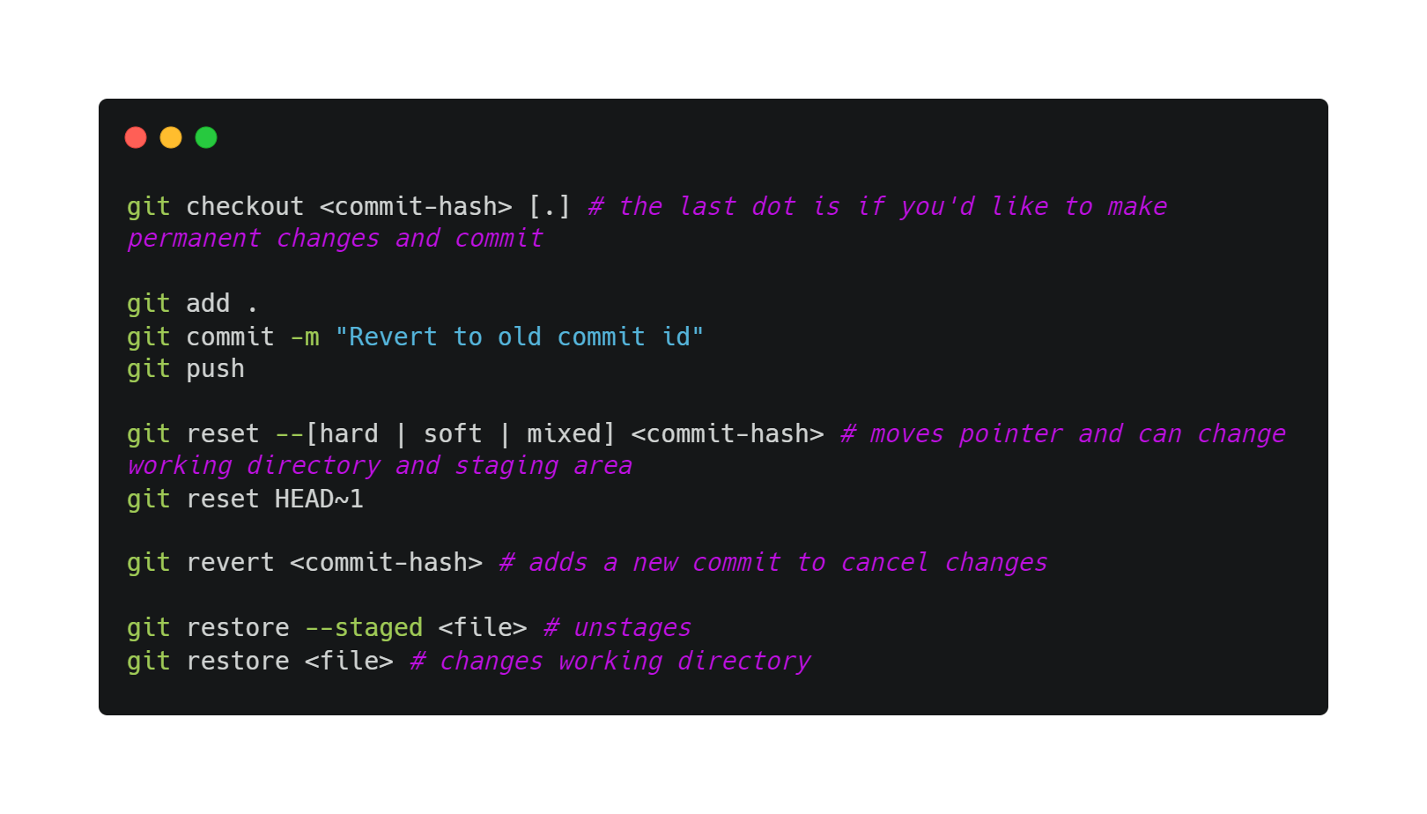
Restoring previous versions

Slide 11
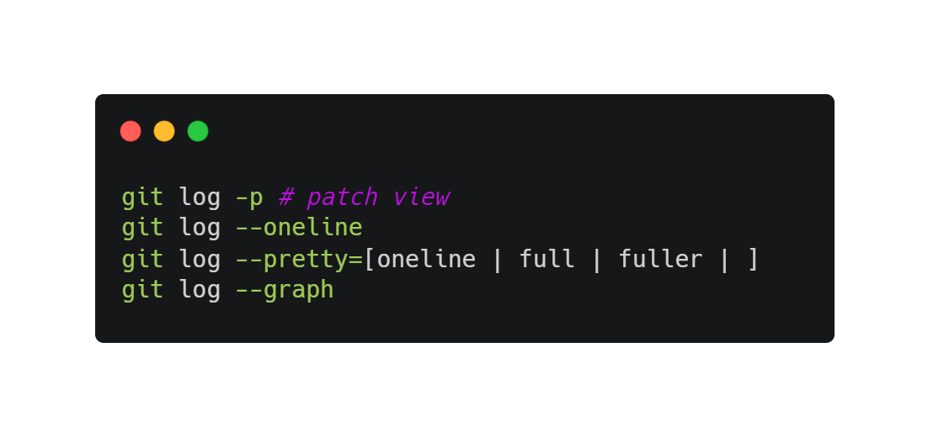
git log

Slide 12

Collaboration
Now, you want to collaboratively write a book.
Create title
Add paragraph 1
Add paragraph 2

Slide 13
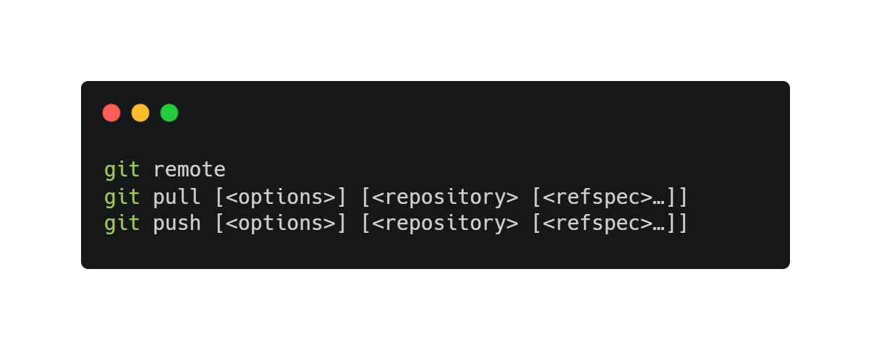
Remote repository, github!
Register an account on Github!
Origin refers to the remote repository’s name by convention.

Slide 14
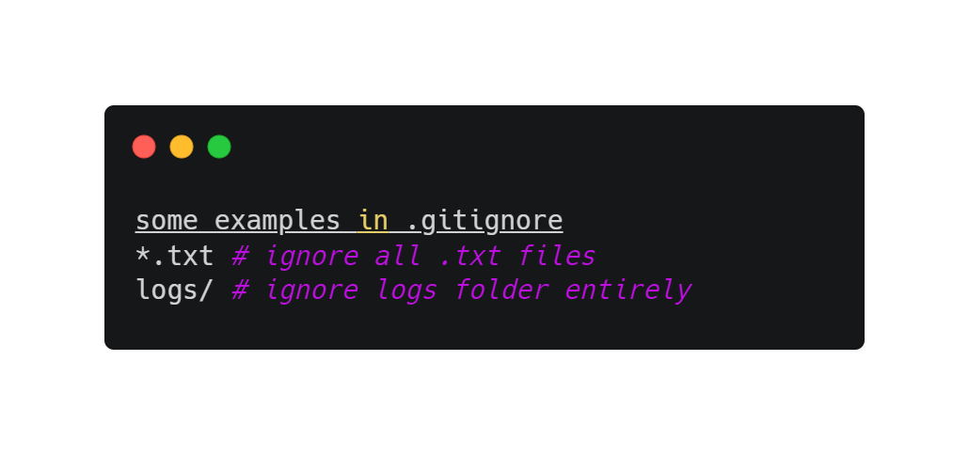
Common additional files
.gitignore is a way to ignore files in Git
README.md is to display text on GitHub

Slide 15
Authentication
https://docs.github.com/en/github/authenticating-to-github/connecting-to-github-with-ssh/about-ssh
SSH and HTTP

Slide 16
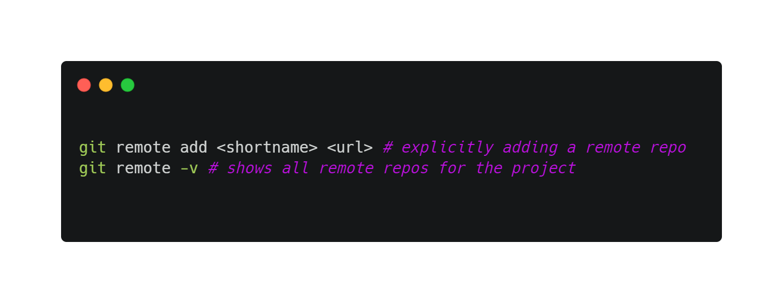
Adding a remote repository
git clone implicitly adds the remote repo for you under the name origin
To add one explicitly:

Slide 17
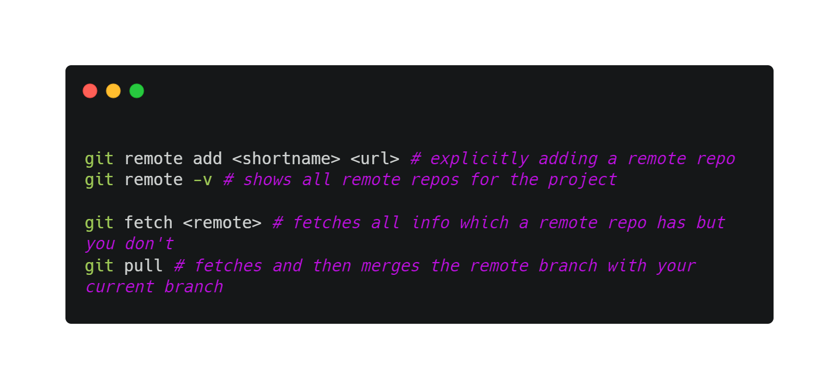
Fetching and pulling
git fetch command only downloads the data to your local repo but it does not merge or modify your work.
You have to do this manually.
git pull fetches the data and then merges that remote branch into your current branch. Additionally, git clone automatically sets up your local main branch to track the remote main branch.

Slide 18
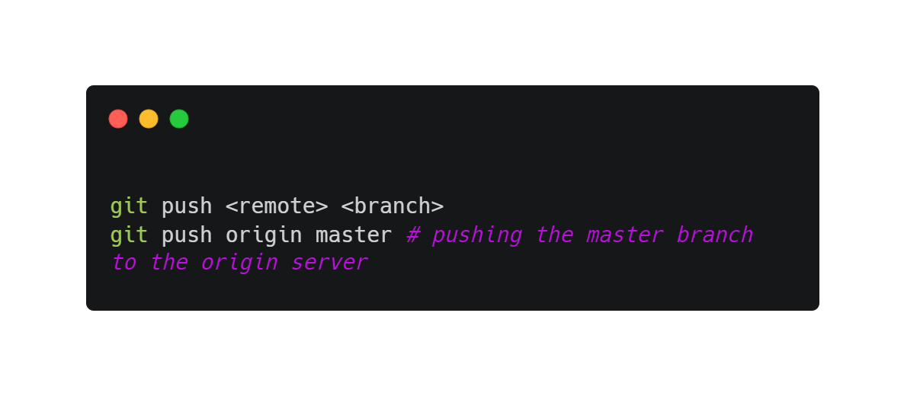
Pushing
Ready to share?
What happens when multiple people push at the same time? How about if you push before pulling?

Slide 19
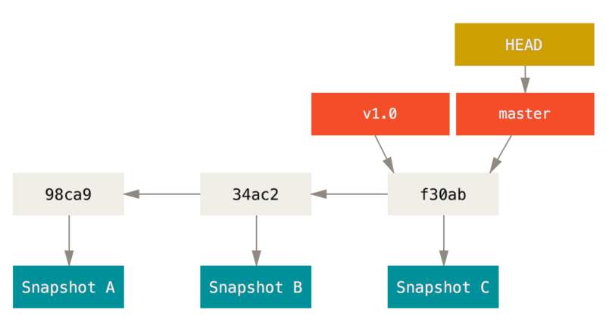
Branching
Diverge from the main development line and do your own stuff without messing the main line
Git stores snapshots, and a pointer that points to those snapshots

Slide 20
Branching
HEAD
Master
bc3ae
e39ae
s7bjk
d42ce
Switching branches changes your current working directory
test
test
HEAD
HEAD

Slide 21
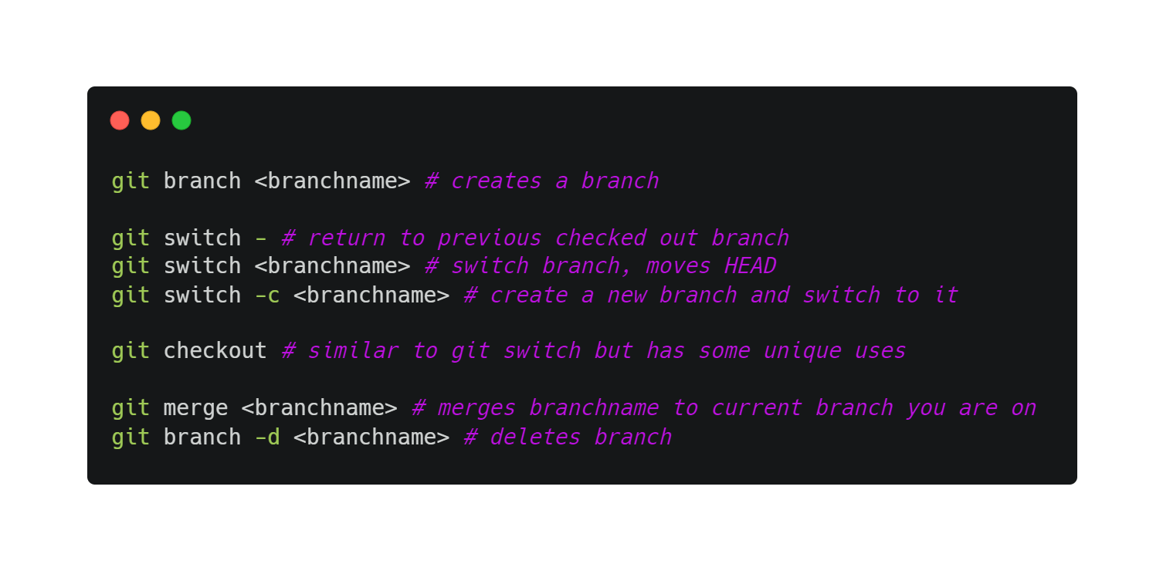
Branching
Switching branches changes your current working directory

Slide 22
Merge conflicts, pull requests, forking
Forking :
i) Propose changes to someone’s project
ii) Use the code as your own project
iii) Does not affect original project

Slide 23
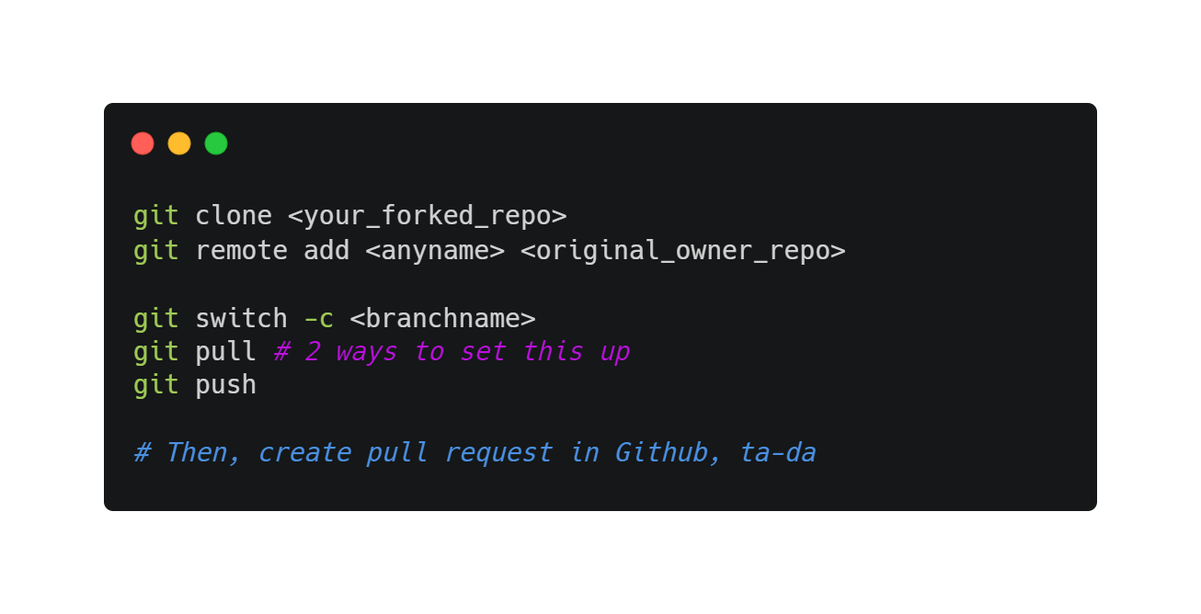
Merge conflicts, pull requests, forking
https://www.atlassian.com/git/tutorials/comparing-workflows/forking-workflow#:~:text=Forking%20is%20a%20git%20clone,org%2FuserA%2Fopen%2Dproject

Slide 24
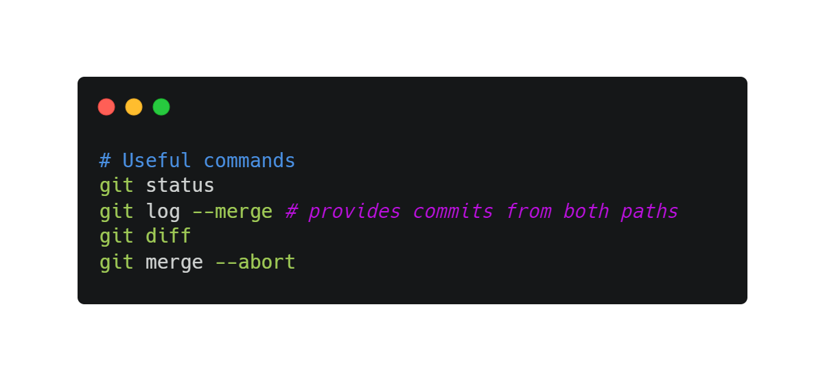
Merge conflicts, pull requests, forking
Once merge and conflict appears, open the file containing conflict
git add, then git commit

Slide 25

Git best practices!
Commit often!
Commit related changes only (wrap related changes)
Commit completed work/changes
Meaningful commit messages

Slide 26
Resources
Pro Git Book
Bash commands
Not covered today
Rebasing, reverting, more advanced git commands
In-depth on how Git works
Git visual tools like GitKraken and VSCode git extension

Slide 27
Technical Issues
Configuring editor for Git (if you don’t use VSCode)

Slide 28
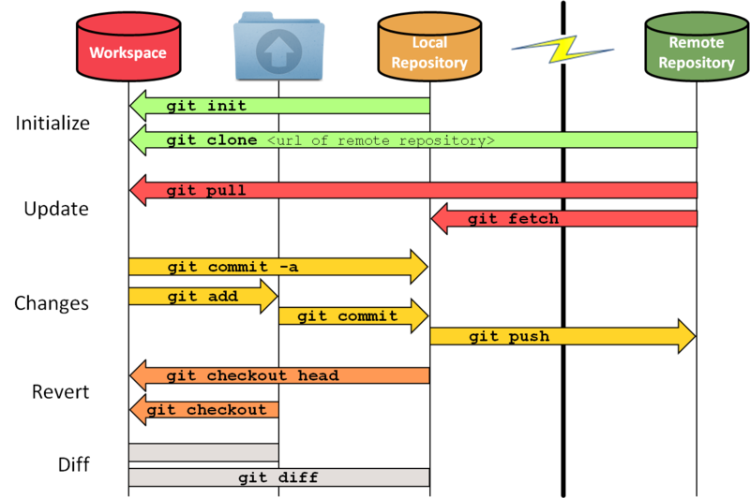
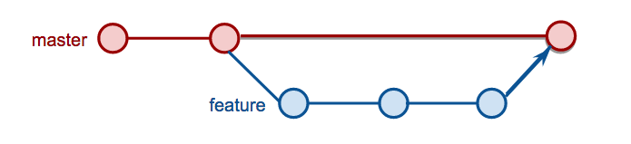
Add. slides/images
Untracked
unmodified
unmodified
Tracked
modified
staged
This Photo by Unknown Author is licensed under CC BY-SA
This Photo by Unknown Author is licensed under CC BY-NC

Slide 29
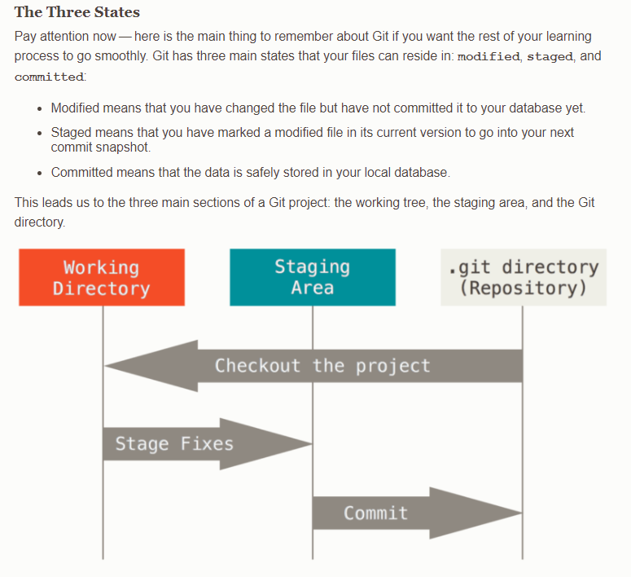
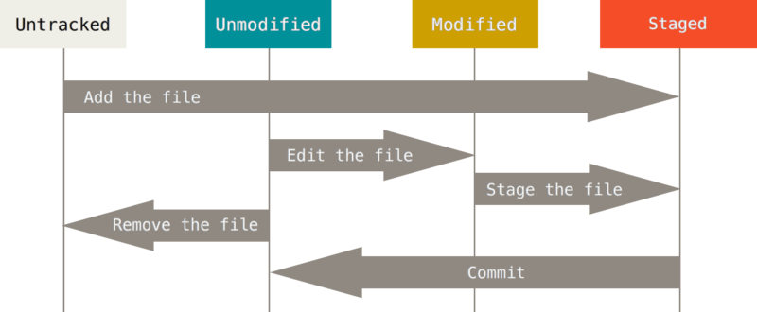
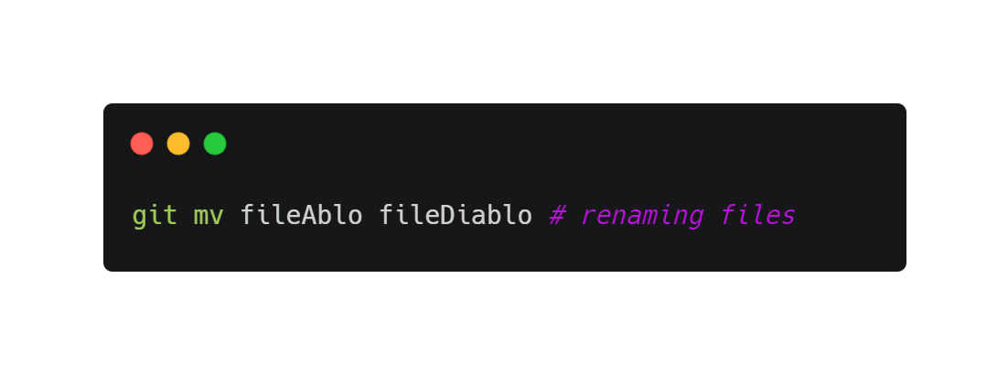
Add. slides/images

Slide 30
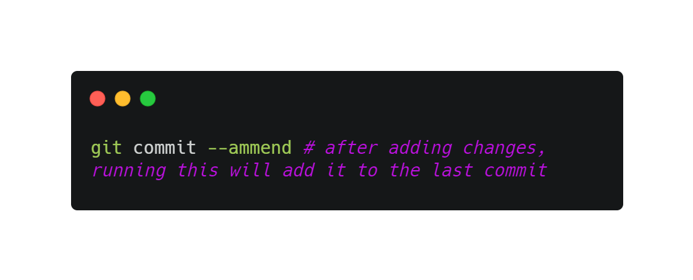
Add. slides/images

Slide 31
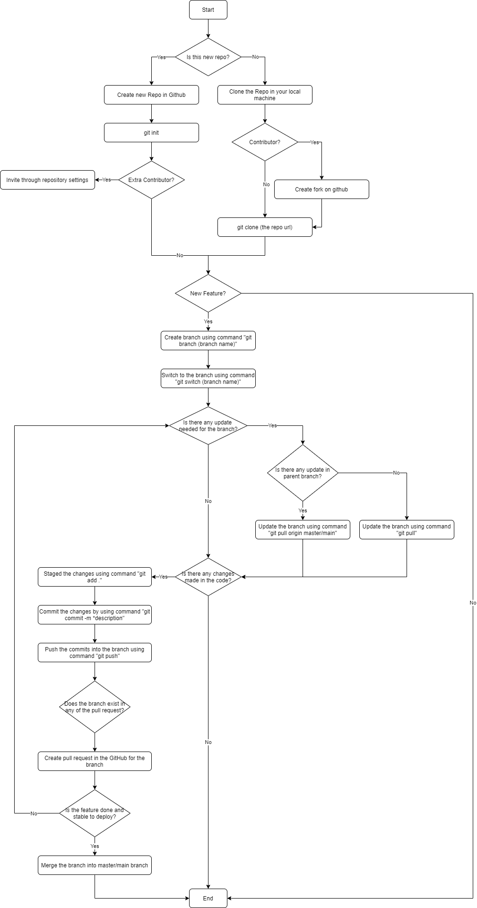
Add. slides/images

